Slide 1
Le corbusier
CONTEMPORARY ARCHITECT -

Slide 2
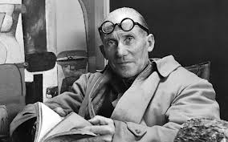
le corbusier

Slide 3
Life of le corbusier
Charles-Edouard Jeanneret better known as Le Corbusier.
He was born in Switzerland on Oct 6 1887 and became a french citizen in 1930
He was an architect, designer,urbanist and a writer.
His career spanned 5 decades with his buildings constructed throughout France America India.

Slide 4
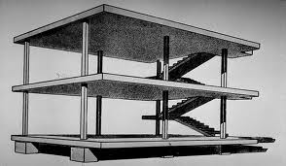
Early years and career...!!
At age 13, Le Corbusier taught at his old school La Chaux-de-Fonds, during the first world war.
Until the end of first world war he worked in Switzerland about theoritical architectural studies using modern techniques.
Among these was his project for Domino house(1914-1915)

Slide 5
5 points of architecture...
The following points in no way relate to aesthetic fantacies or a striving for fashionable effects but concern architectural facts that imply an entirely a new kind of building.
1.THE SUPPORTS
2.THE GARDEN ROOFS
3.FREE DESIGN OF GROUD FLOOR PLAN
4.HORIZONTAL WINDOWS
5.FREE DESIGN OF THE FACADE
These points mentioned above are fundamentally new aesthetic.

Slide 6
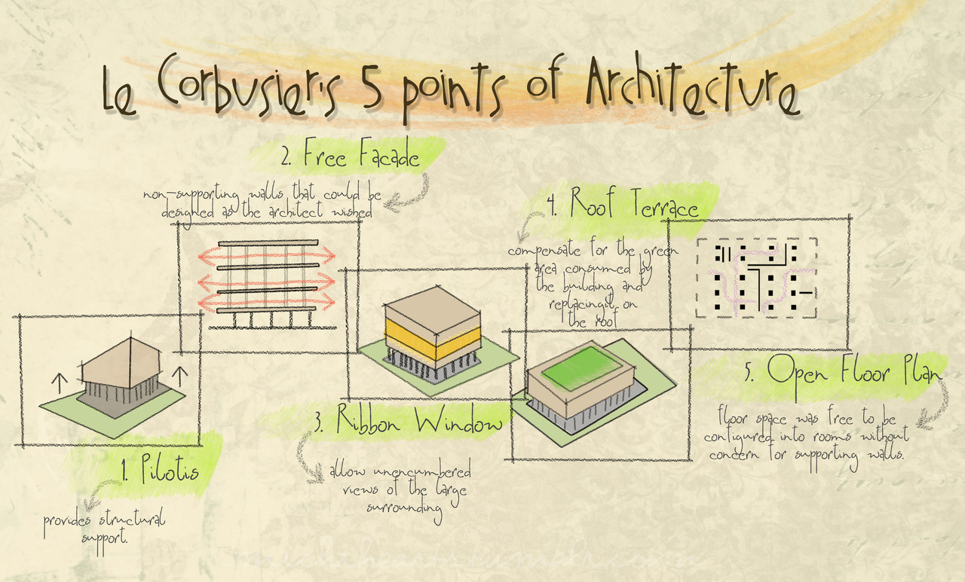

Slide 7
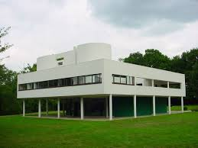
VILLA SAVOYE
The Villa Savoye is a wonderfull demonstration of Le Corbusier’s five points of a new architecture, which he developed in 1927, exploiting the new opportunities of reinforced concrete.

Slide 8
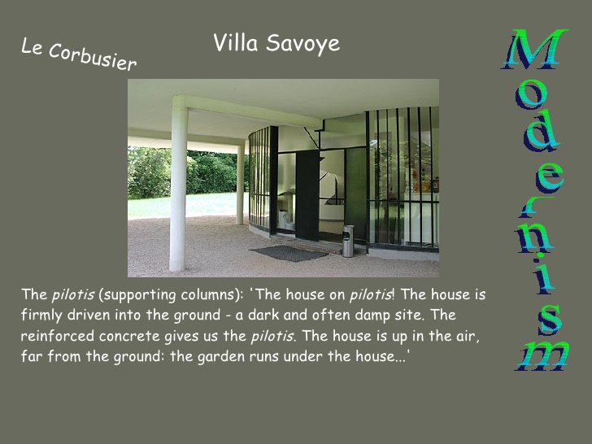

Slide 9
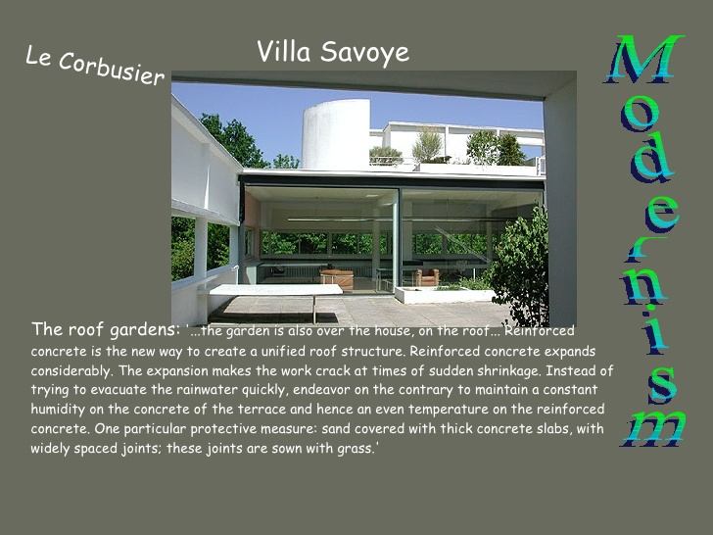

Slide 10
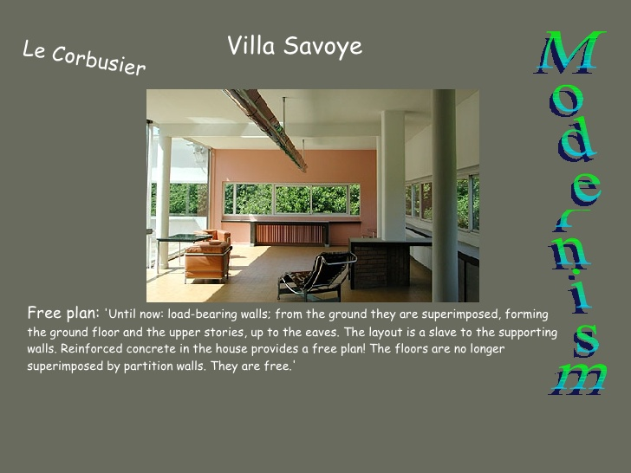

Slide 11
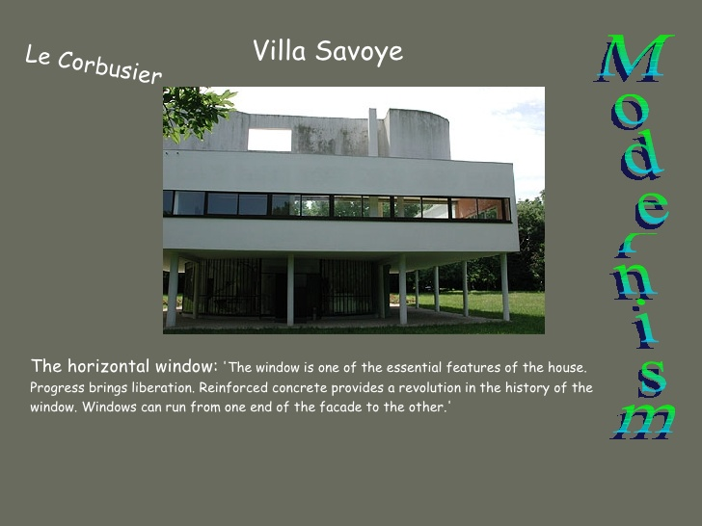

Slide 12
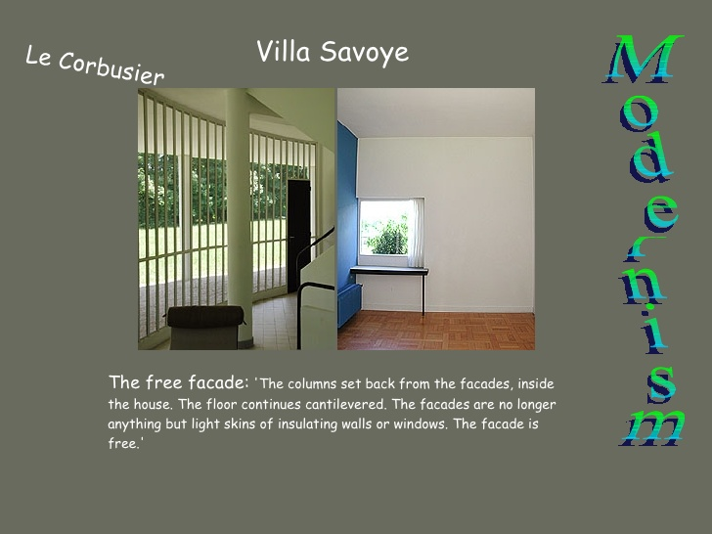

Slide 13
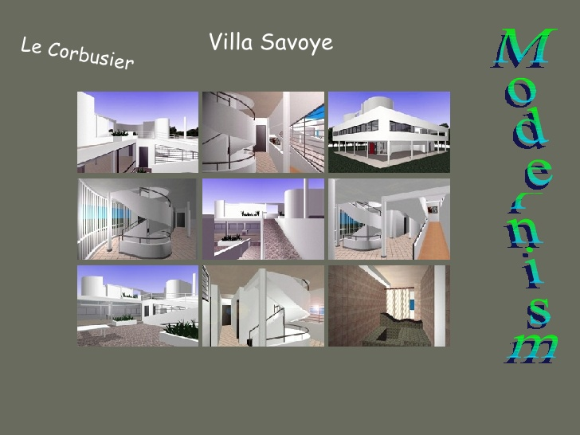

Slide 14
SOME OF THE FAMOUS BUILDINGS OF LE CORBUSIER...!!

Slide 15
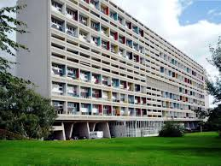
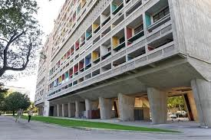
Unité d'Habitation

Slide 16
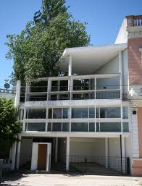
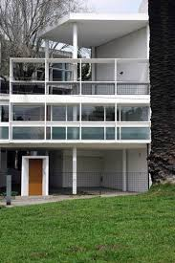
Curutchet House

Slide 17
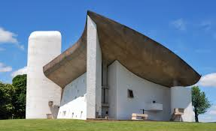
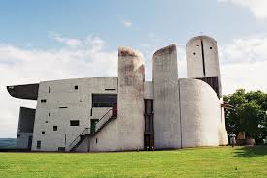
Notre Dame du Haut

Slide 18
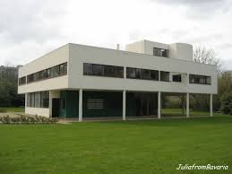
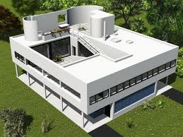
Villa Savoye

Slide 19
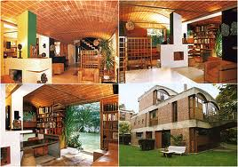
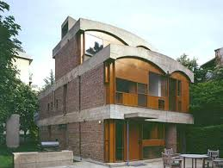

Slide 20
